Slide 1
Feature Representation,
Extraction, and Selection
By Yaohang Li, Ph.D. Department of Computer Science Old Dominion University yaohang@cs.odu.edu

Slide 2
Agenda
Features
Feature Representation
Feature Selection
Feature Engineering
Traditional Feature Engineering
Automatic Feature Engineering

Slide 3
Feature in Machine Learning
A Feature
Individual measurable property of a phenomenon being observed
Usually Numeric
Can be structural
Strings
Graphs
Feature Vector
An n-dimensional vector of numerical features representing some object

Slide 4
Good Features
Representing, selecting, and extracting good features are a crucial step for effective machine learning algorithms
Good Features
Discriminative
Different values for samples of different classes
Almost same values for very similar samples
Interpretable
Features that are easier to understand by human experts
Corresponding to object characteristics
Independent
Features are not redundant
Efficient
Reduce the complexity of the model
Reduce overfitting

Slide 5
Feature Engineering
Data in real life
Many irrelevant and redundant variables
Often comparably few training examples
Feature Engineering
Finding good feature representations
Feature selection
Feature extraction
Applications
Text/document processing
Gene expression array analysis
Images/videos

Slide 6
Agenda
Features
Feature Representation
Feature Selection
Feature Engineering
Traditional Feature Engineering
Automatic Feature Engineering

Slide 7
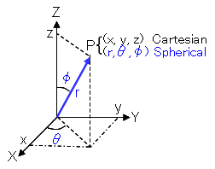
Feature Representations
Features can be represented in different ways
Equivalent Mathematically
Behave Differently in Machine Learning Algorithms
A good representation can lead to
Better Convergence
Faster Convergence
Less Errors
Example: A point in space
(x, y, z)
(r, θ, φ)

Slide 8
Spherical and Cartesian Representation in Nuclear Event Generation GAN
Yasir Alanazi, N. Sato, Tianbo Liu, W. Melnitchouk, Michelle P. Kuchera, Evan Pritchard, Michael Robertson, Ryan Strauss, Luisa Velasco, Yaohang Li, Simulation of electron-proton scattering events by a Feature-Augmented and Transformed Generative Adversarial Network (FAT-GAN), 2020.

Slide 9
Scaling Normalization
Scaling Normalization
Standard
z = (x - u) / s
u: mean of the data
s: standard deviation
Minmax
Convert all data into [0, 1]
Maxabs
Scale each feature by its maximum absolute value
Robust Scaler
Scale features using statistics that are robust to outliers

Slide 10
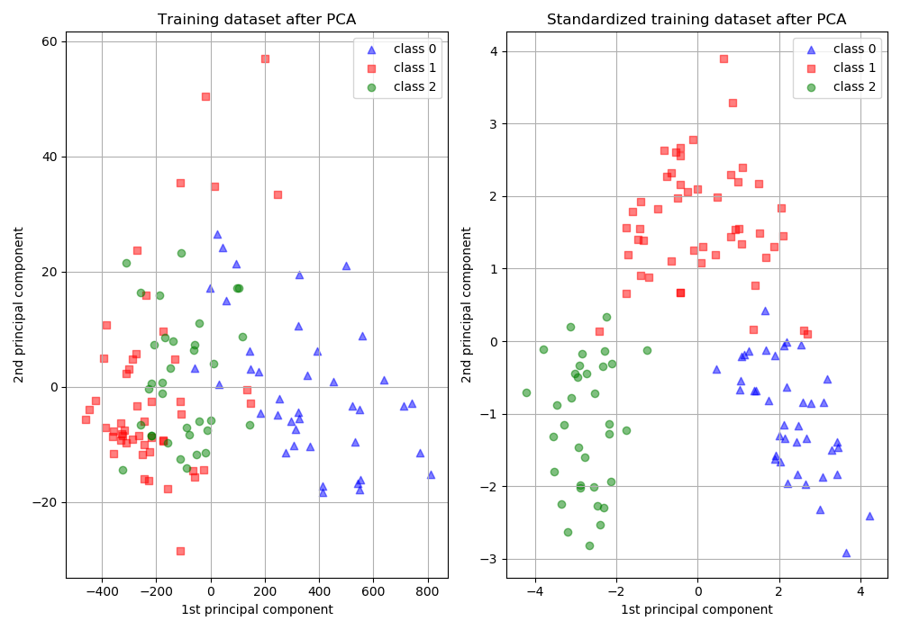
Demo: The Importance of Scaling
Jupyter notebook scaling.ipynb

Slide 11
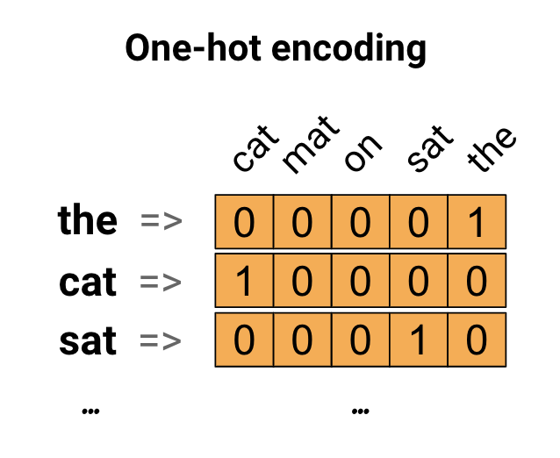
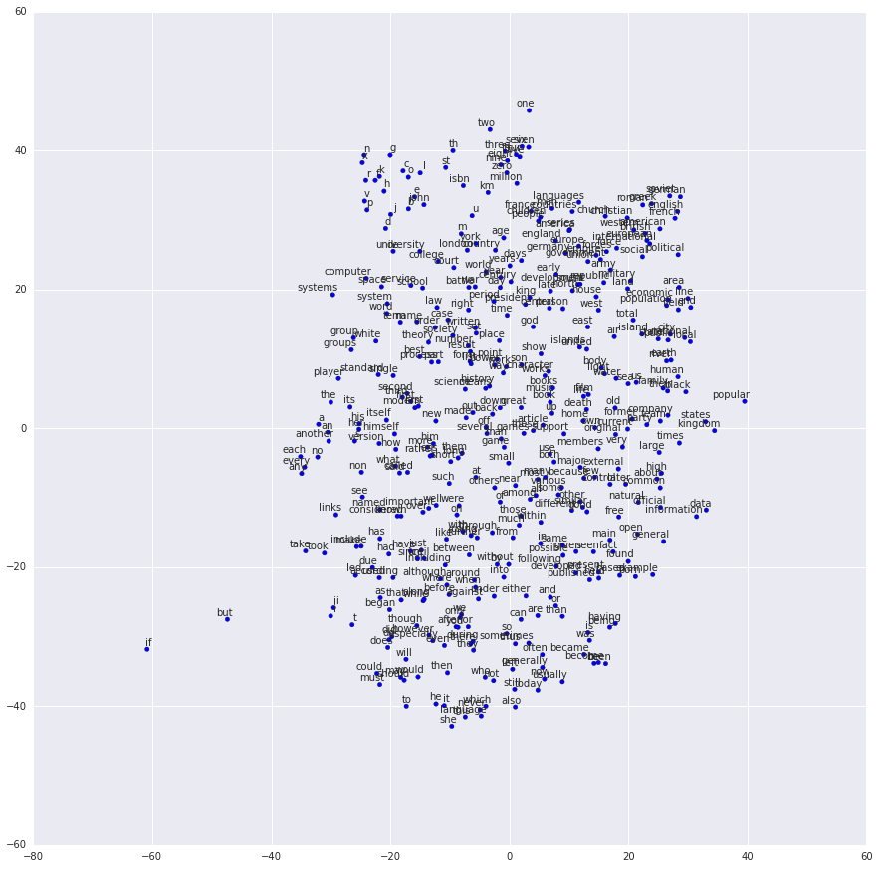
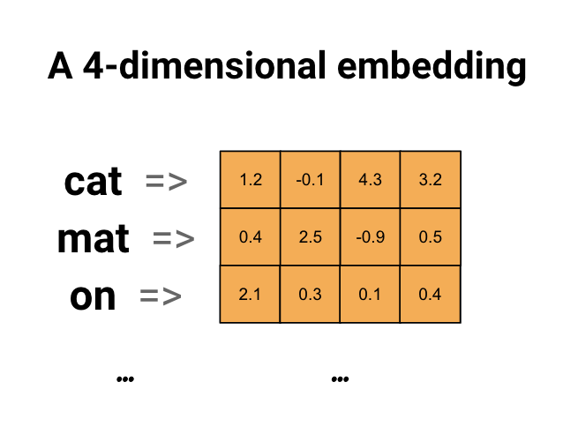
Dense Representation
Projection of Dense Word Vectors
word2vec

Slide 12
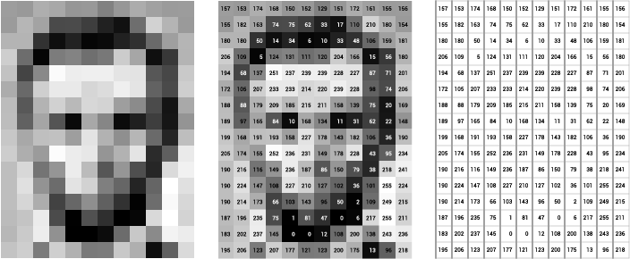

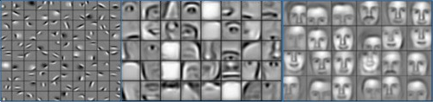
Example of Representations in Face Recognition
Methods | Features | Accuracy
Pixels |  | 82.1%
Eigenfaces |  | 92.7%
CNN |  | 99.6%

Slide 13
Agenda
Features
Feature Representation
Feature Selection
Feature Engineering
Traditional Feature Engineering
Automatic Feature Engineering

Slide 14
Feature Selection
What is feature selection?
A way to select the most relevant features to find more accurate, faster, and easier to understand classifiers
Metrics
Performance
Enhancing generalization capability
Alleviating the effect of curse of dimensionality
The higher the ratio of the number of training patterns N to the number of free classifier parameter, the better the generalization of the learned classifier
Efficiency
Accelerating the learning process
Interpretability
Resulting in a model that is easy to understand

Slide 15
When Feature Selection is Needed?
Noisy Data
Lots of low frequent features
Multi-type features
Too many features compared to the number of samples
Complex model

Slide 16
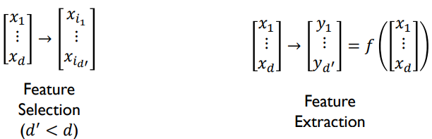
Feature Selection vs. Feature Extraction
Feature Selection
Select a subset of a given feature set
Without changing the features
Feature Extraction (Dimension Reduction)
A linear or non-linear transform on the original feature space

Slide 17
Feature Selection Strategies
Univariate methods
Consider the features one at a time
Rank features
Multivariate methods
Consider whole groups of variables together
Select feature subset

Slide 18
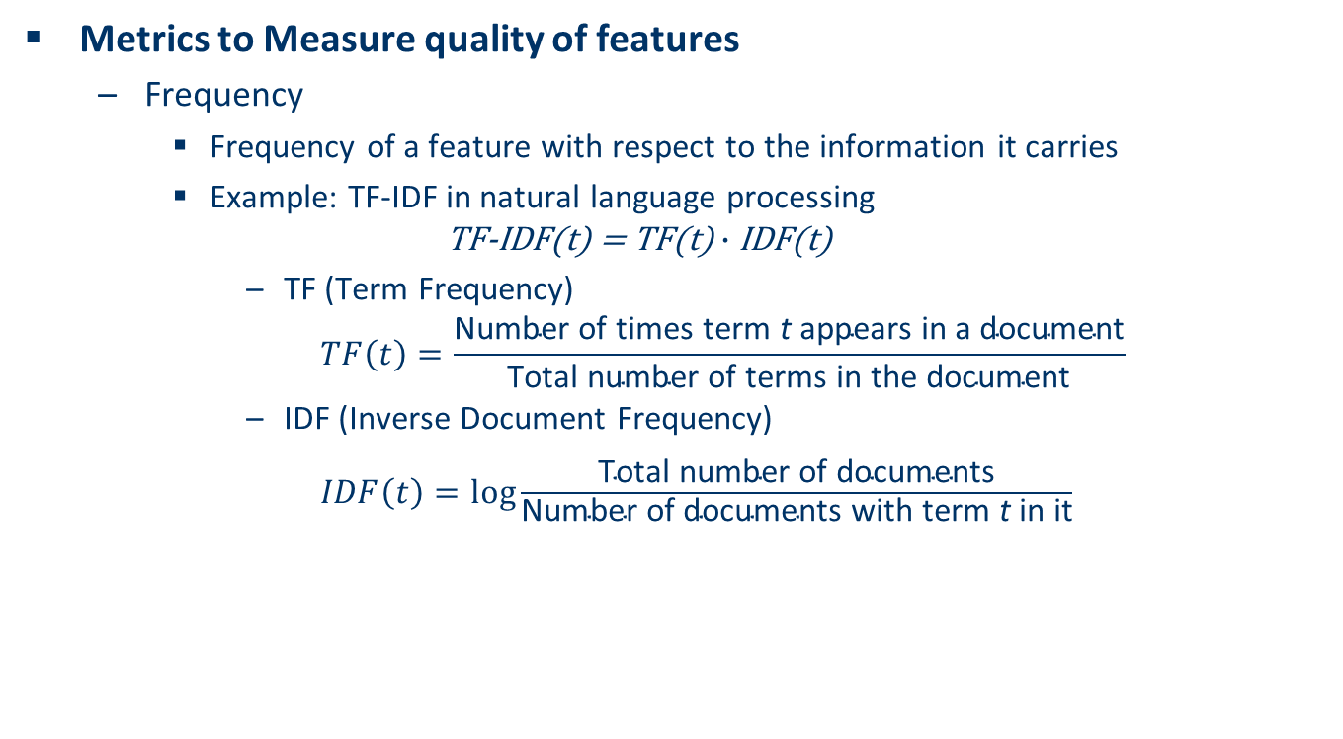
Univariate Feature Selection – Frequency
Metrics to Measure quality of features
Frequency
Frequency of a feature with respect to the information it carries
Example: TF-IDF in natural language processing
$$\text{TF}\text{-}\text{IDF}\text{(}\text{t}\text{) = }\text{TF}\text{(}\text{t}\text{)}∙\text{IDF}\text{(}\text{t}\text{)}$$
TF (Term Frequency)
$$TF\left(t\right)=\frac{\text{Number} \text{of} \text{times} \text{term} \text{t} \text{appears} \text{in} \text{a} \text{document}}{\text{Total} \text{number} \text{of} \text{terms} \text{in} \text{the} \text{document}}$$
IDF (Inverse Document Frequency)
$IDF\left(t\right)=log⁡\frac{\text{Total} \text{number} \text{of} \text{documents}}{\text{Number} \text{of} \text{documents} \text{with} \text{term} \text{t} \text{in} \text{it}}$

Slide 19
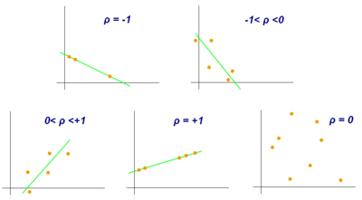
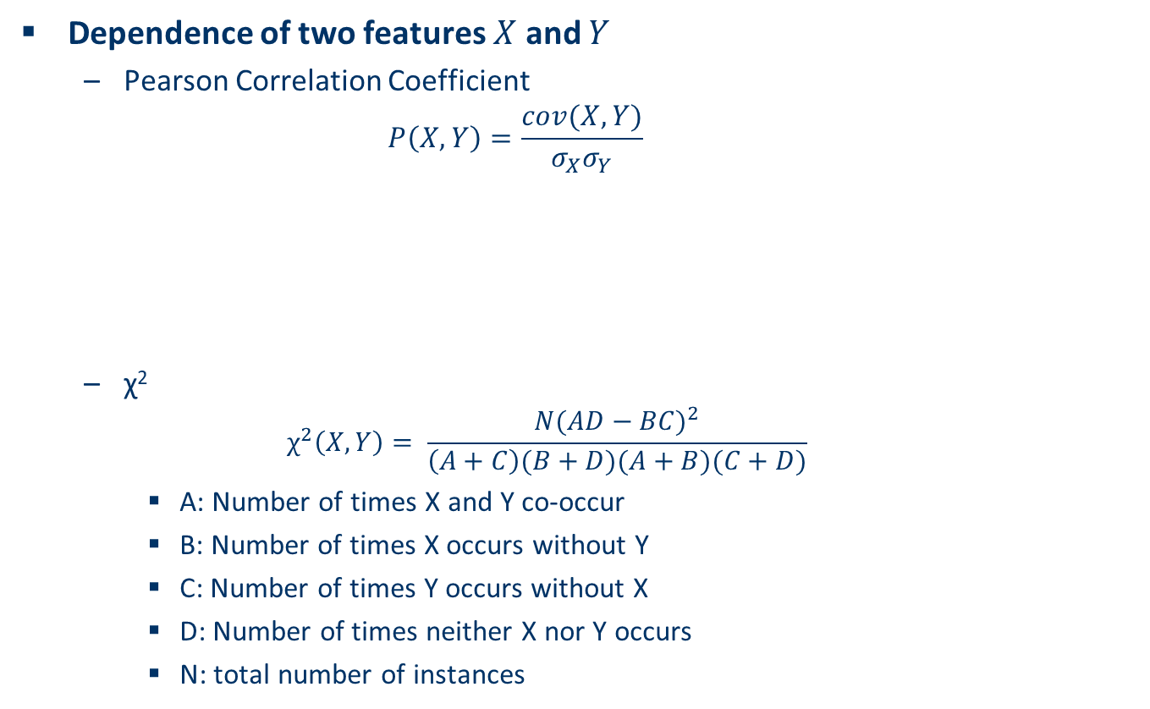
Univariate Feature Selection – Mutual Information
Dependence of two features $X$ and $Y$
Pearson Correlation Coefficient
$$P\left(X,Y\right)=\frac{cov(X,Y)}{σ_{X}σ_{Y}}$$
χ²
$$χ^{2}\left(X, Y\right)= \frac{N{(AD−BC)}^{2}}{\left(A+C\right)(B+D)(A+B)(C+D)}$$
A: Number of times X and Y co-occur
B: Number of times X occurs without Y
C: Number of times Y occurs without X
D: Number of times neither X nor Y occurs
N: total number of instances

Slide 20
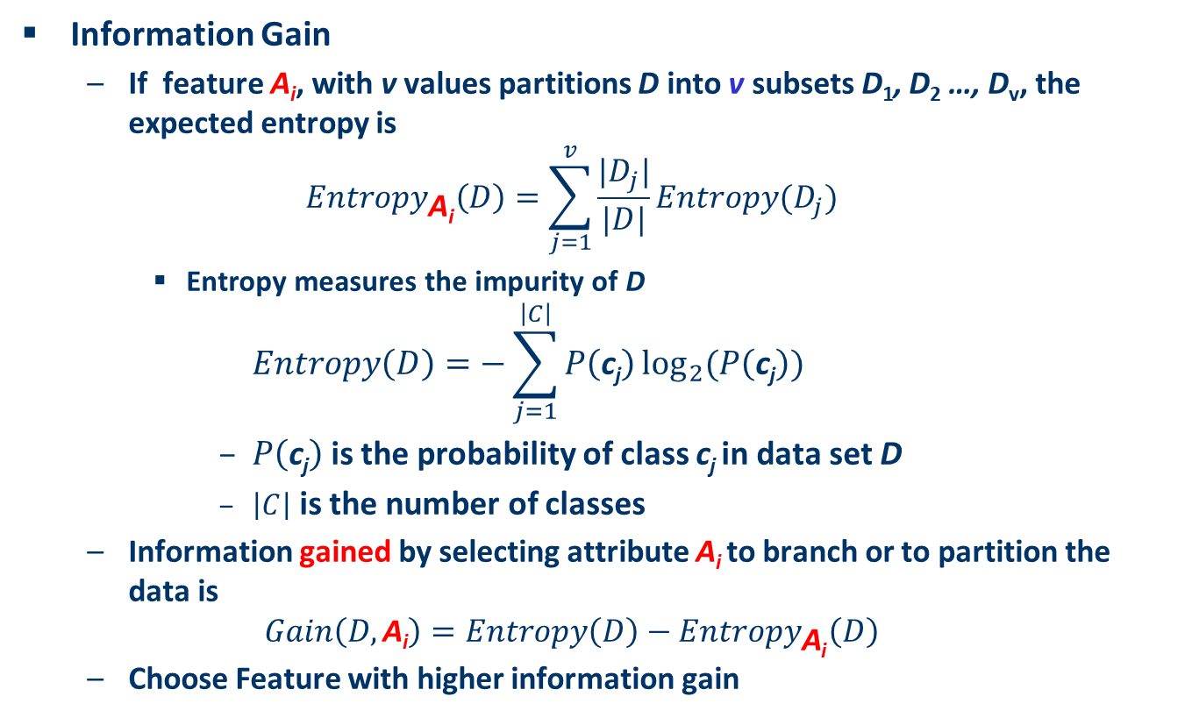
Univariate Feature Selection – Information Gain
Information Gain
If feature A_{i}, with v values partitions D into v subsets D₁, D₂ …, D_{v}, the expected entropy is
$${Entropy}_{\text{A}\text{i}}\left(D\right)=\sum_{j=1}^{v}{\frac{|D_{j}|}{|D|}}Entropy(D_{j})$$
Entropy measures the impurity of D
$$Entropy\left(D\right)=−\sum_{j=1}^{\left|C\right|}{P\left(\text{c}\text{j}\right)}\log_{2}⁡(P\left(\text{c}\text{j}\right))$$
$P\left(\text{c}\text{j}\right)$ is the probability of class c_{j} in data set D
$\left|C\right|$ is the number of classes
Information gained by selecting attribute A_{i} to branch or to partition the data is
$$Gain\left(D,\text{A}\text{i}\right)=Entropy\left(D\right)−{Entropy}_{\text{A}\text{i}}\left(D\right)$$
Choose Feature with higher information gain

Slide 21
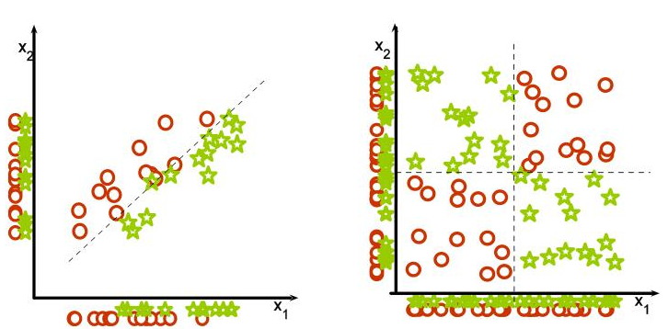
Univariate Feature Selection May Fail
Guyon-Elisseeff, JMLR 2004.

Slide 22
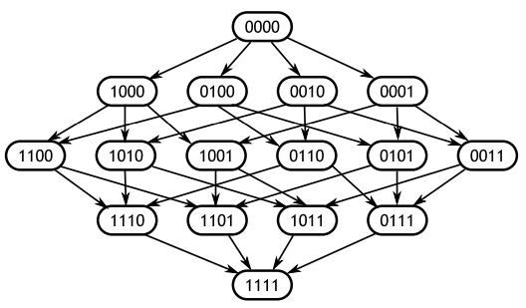
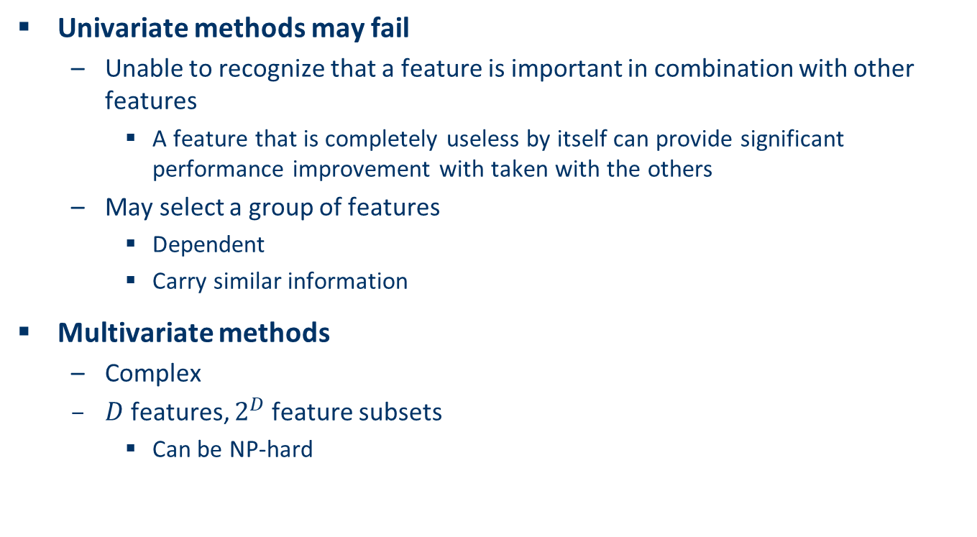
Univariate Feature Selection vs. Multivariate Feature Selection
Univariate methods may fail
Unable to recognize that a feature is important in combination with other features
A feature that is completely useless by itself can provide significant performance improvement with taken with the others
May select a group of features
Dependent
Carry similar information
Multivariate methods
Complex
$D$ features, $2^{D}$ feature subsets
Can be NP-hard

Slide 23
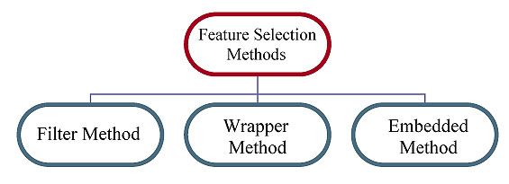
Classification of Feature Selection Methods
Filter Method
Select/rank a subset of features independently of the predictor
Predictor is not involved
Wrapper Method
Use a predictor to assess features
Predictor is involved
Embedded Method
Feature selection is built in the machine learning models

Slide 24

Filter Methods
Filter Methods
Select features on the basis of their scores in various statistical tests for their correlation with the outcome variable (response)
Independent of predictor and machine learning algorithm
Criterion Guideline
Notes:
LDA: Latent Dirichlet allocation

Slide 25
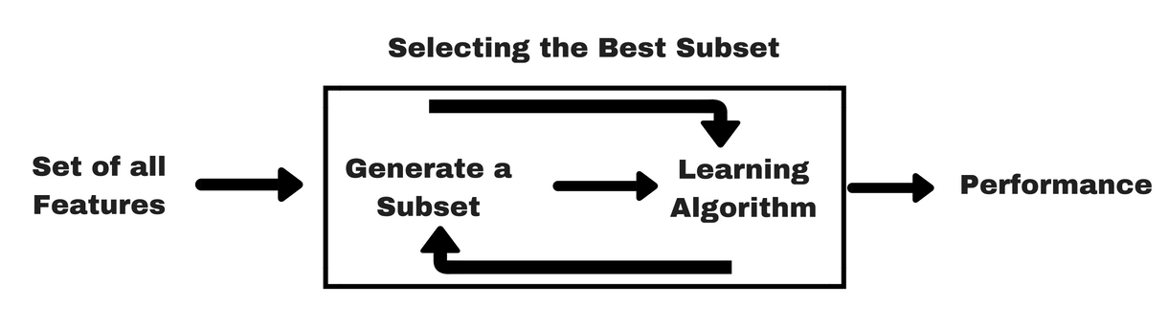
Wrapper Methods
Wrapper Methods
Sequential forward selection
Start from no feature
Adding new features gradually
Until no performance improvement
Sequential backward elimination
Start from all features
Removing features gradually
Usually those have low correlation with the response
Until no performance improvement
Recursive feature elimination
Greedy optimization algorithm

Slide 26
Wrapper Methods – Recursive Feature Elimination
Recursive Feature Elimination
Greedy optimization
Repeatedly create models and eliminate the worst performance one at each iteration
Construct the next model with the left-over features
Rank features based on the order of their elimination

Slide 27
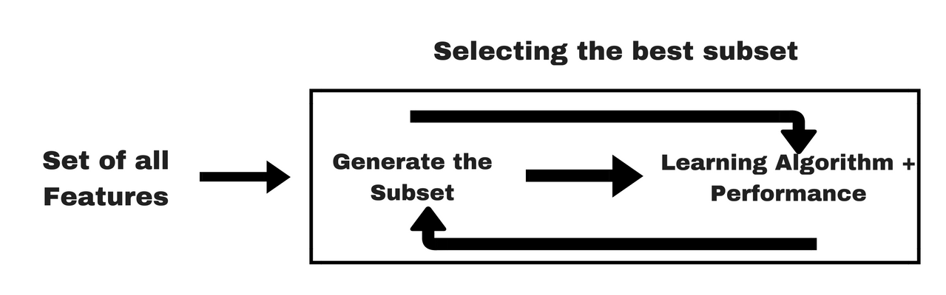
Embedded Methods
Embedded Methods
Use machine learning algorithms with built-in feature selection method
Examples
LASSO regression
Decision trees

Slide 28
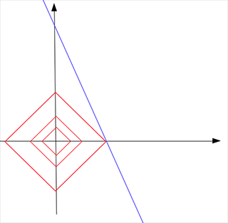
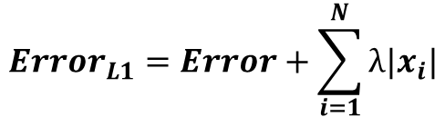
Regression with LASSO
L1 regularization will lead to sparse solution
$${Error}_{L1}=Error+\sum_{i=1}^{N}{λ|x_{i}|}$$

Slide 29
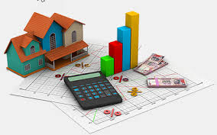
Demo: Feature Selection
Jupyter Notebook feature_selection.ipynb

Slide 30
Agenda
Features
Feature Representation
Feature Selection
Feature Engineering
Traditional Feature Engineering
Automatic Feature Engineering

Slide 31
Traditional Feature Engineering
Feature Engineering in Traditional Machine Learning
Data Preprocessing
Data Cleansing
Removing outliers
Removing noise
Fill-in missing values
Feature Encoding and Representation
Feature Selection
Feature Scaling and Transformation
Feature Extraction and Dimension Reduction
Model Building
Test and Validation
Human Involved

Slide 32

Kaggle House Price Prediction Challenge
Ask a home buyer to describe their dream house, and they probably won't begin with the height of the basement ceiling or the proximity to an east-west railroad. But this playground competition's dataset proves that much more influences price negotiations than the number of bedrooms or a white-picket fence.
With 79 explanatory variables describing (almost) every aspect of residential homes in Ames, Iowa, this competition challenges you to predict the final price of each home.

Slide 33
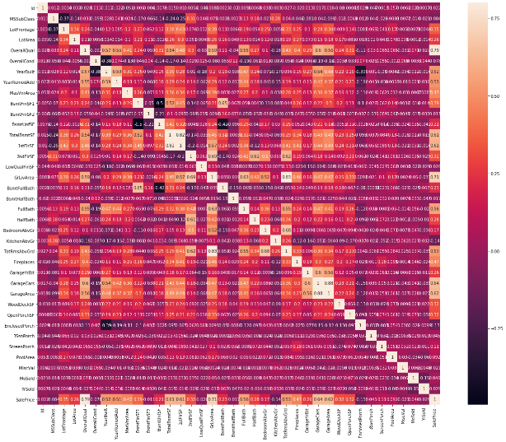
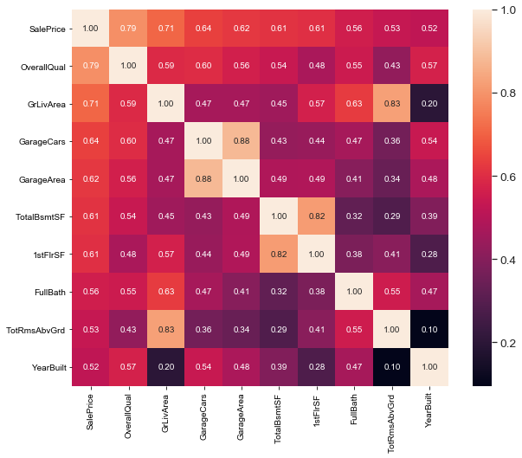
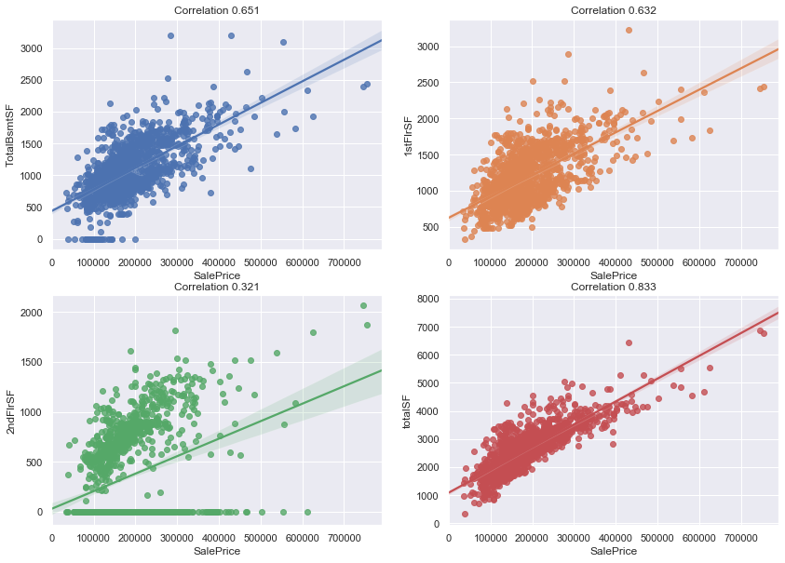
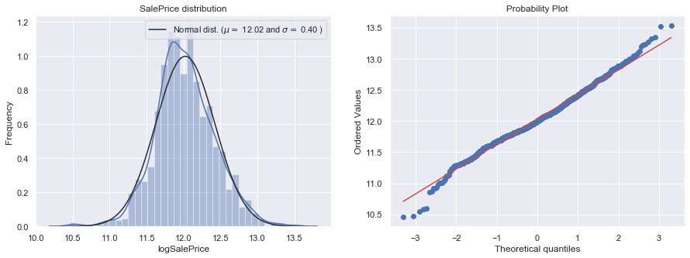
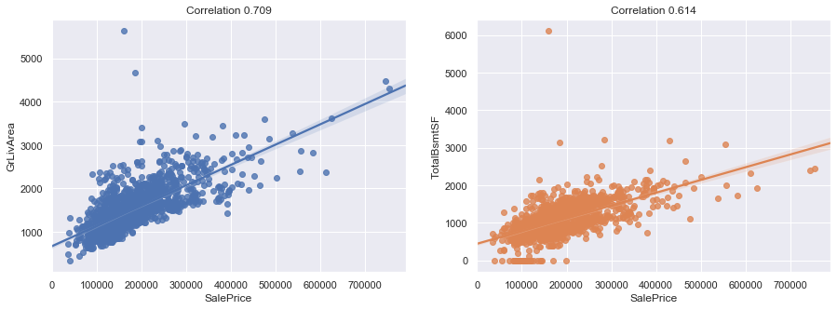
Traditional Feature Engineering
Analyzing Feature Correlations
Feature Selection
Features Extraction
Feature Transformation
Outlier Removals

Slide 34
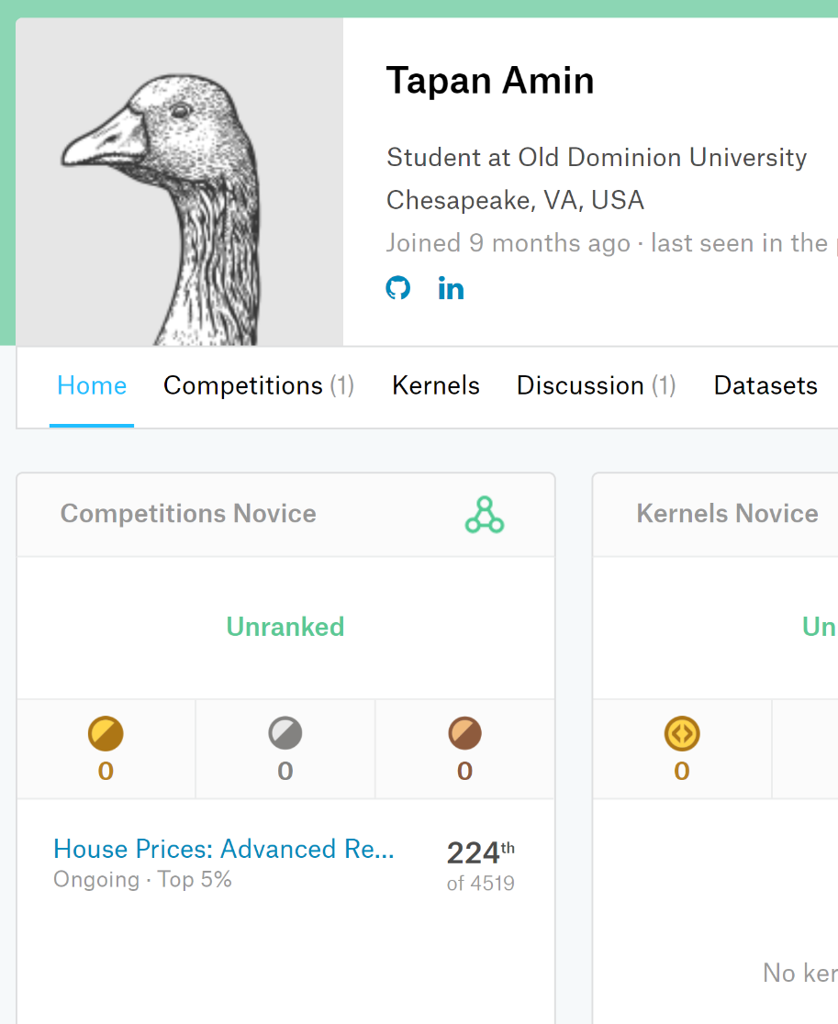
House Price Prediction
Score | Rank | Leaderboard
0.42566 | 4290 | top 94%
0.18078 | 3570 | top 75%
0.16716 | 3320 | top 70%
0.12665 | 1450 | top 30%
0.12041 | 925 | top 21%
0.11747 | 680 | top 15%
0.11619 | 533 | top 11%
0.11501 | 224 | top 5%

Slide 35
Automatic Feature Learning
Traditional Feature Engineering
Requires a lot of human involvement
Time consuming
Costly
Inefficient
Automatic Feature Learning
Features are learned by machine
with limited human intervention
As good as or better than human

Slide 36
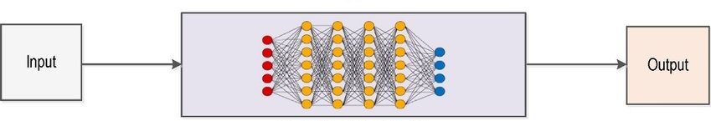
End-to-End Learning
An End-to-End Model
The machine learning model automatically learns all features that can occur between the original input and the final input
Directly convert input data into output prediction
Bypassing intermediate steps

Slide 37
Examples of End-to-end Learning

Slide 38

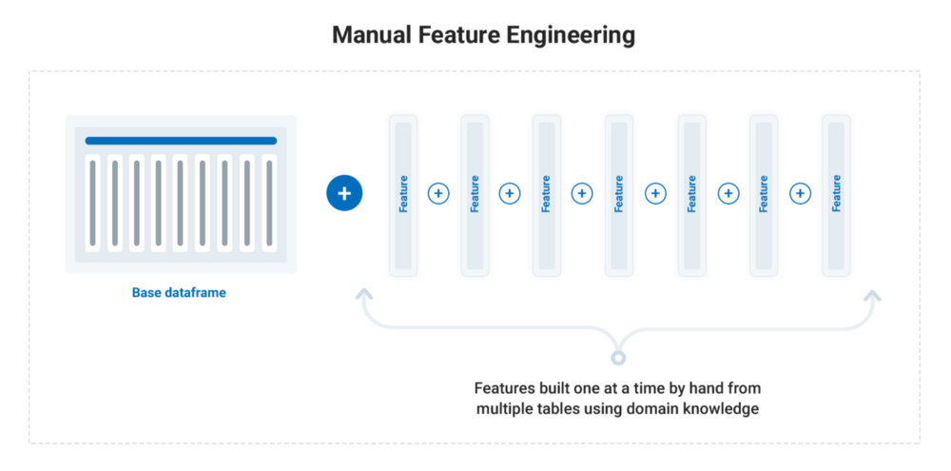
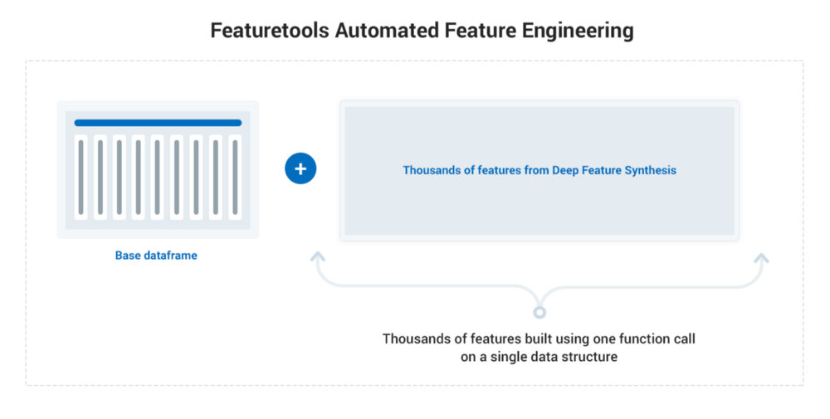
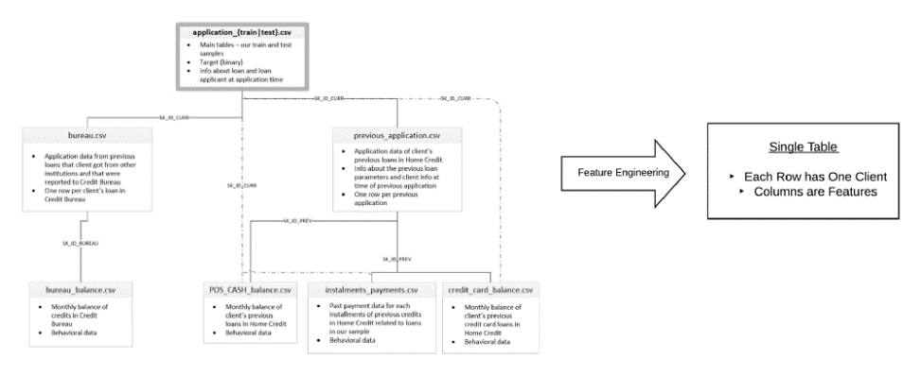
Automatic Feature Engineering using Feature Tools

Slide 39
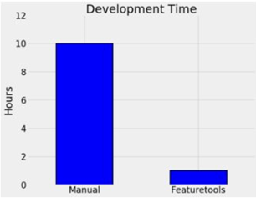
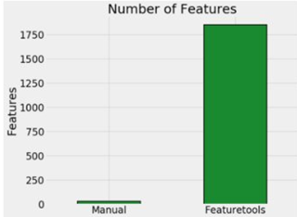
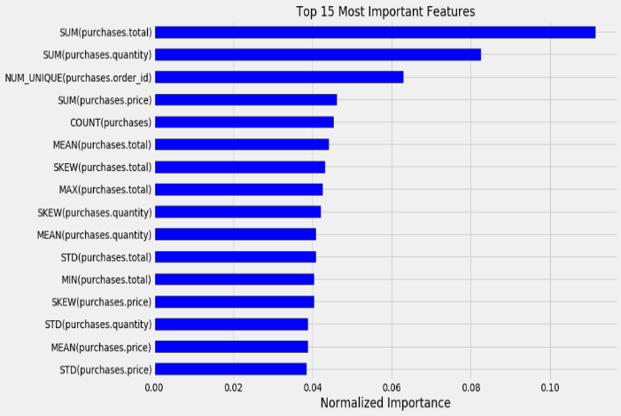
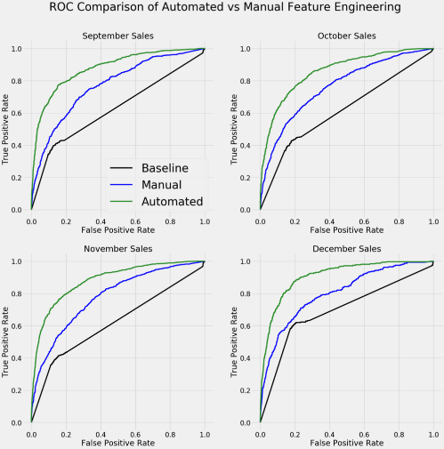
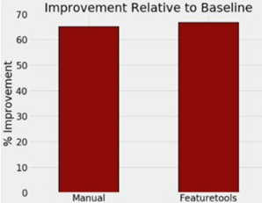
Automatic Feature Learning with Feature Tools
Human Time Involved
Features Discovered
Performance

Slide 40
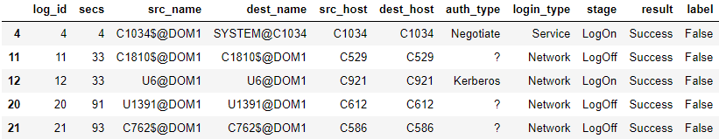
Demo: Automatic Feature Learning
Jupyter notebook PredictingMaliciousCyberConnectionswithFeaturetools.ipynb

Slide 41
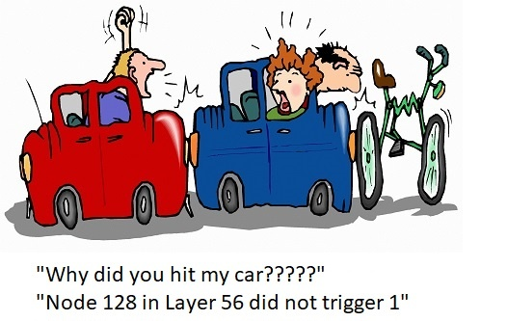
Limitation of End-to-End Learning
Explainability
Learned features are not straightforward to modified
May be inefficient
Can be overtaken by transfer learning and domain adaptations

Slide 42
Summary
Importance of Features
Representations
Transformation
Selection
Extraction
Engineering
End-to-End Learning
Good Features are the key to machine learning success

